Slide 1










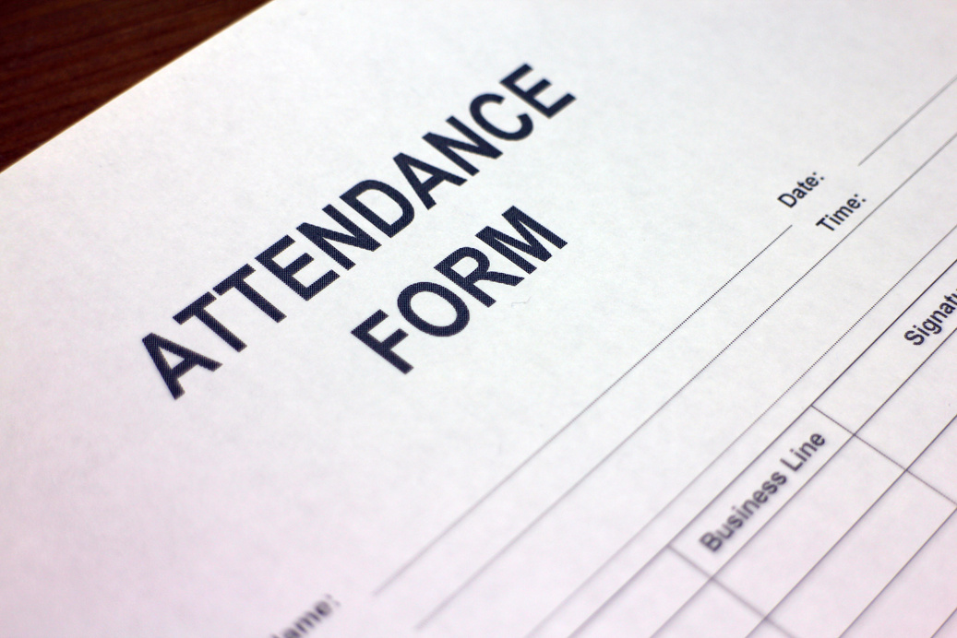

St. Cuthbert’s Catholic
Primary School
EXPLORE
Attendance
GOOD ATTENDANCE
AND
PUNCTUALITY
GUIDE
Every day counts

Slide 2

St. Cuthbert’s Catholic
Primary School
Excellent attendance at school is important to allow your child to fulfil their potential and for them to have the best possible start in life. Although we aim for 100%, each year we set a target for attendance and this is used to compare us to other schools nationally.
Our current target is 97% attendance.
Below are just some of the reasons why it is so important children attend school:
  To learn
  To have fun and make new friends
  To understand responsibility
  To experience new things
  To develop awareness of other cultures, religions, ethnicity and gender differences
  To achieve
  To gain qualifications
  To develop new skills
  To build confidence and self-esteem
  To grow as individuals
Please help us to help your child by encouraging regular school attendance and good punctuality.
Regular attendance helps children to develop confidence and to make lasting friendships.

Slide 3
St. Cuthbert’s Catholic
Primary School
Children who regularly miss school without good reason are more likely to become isolated from their friends, underachieve and/or become involved in anti-social behavior.
We colour-code every child’s attendance, depending on how many days they have attended school.
Remember, our target is to achieve at least 97%.
TRAFFIC LIGHT ZONE
If your child has 90% attendance, they will have the equivalent of:
  ½ day off per week
  19 days off per year
  247 days off over their school career of 13 academic years, the equivalent to over 1 year of lost education!
RED ZONE
All pupils whose attendance falls below 91% will be considered for legal monitoring by the Local Authority
Consider what this means for attendance lower that 90%
AMBER ZONE
Those pupils who have fallen between 91%-96% are in the Amber Zone. Those in this zone are automatically monitored by school.
RESEARCH SHOWS THAT PUPILS WHO ATTEND SCHOOL REGULARLY ARE MORE LIKELY TO DO WELL IN THE FUTURE
GREEN ZONE
All pupils whose attendance is 97% and above are part of the green zone. As Green a pupil you are more likely to achieve.
IF YOU TAKE YOUR CHILD ON A 2 WEEK HOLIDAY IN TERM TIME, ATTENDANCE FOR THE YEAR IMMEDIATELY DROPS TO 95%.
STUDENTS WITH RED AND AMBER ATTENDANCE ARE FAR MORE LIKELY TO UNDERACHIEVE...

Slide 4


St. Cuthbert’s Catholic
Primary School
Holidays and Sporting Events
PLEASE THINK CAREFULLY BEFORE TAKING YOUR CHILD OUT OF SCHOOL DURING TERM TIME
In law, you must ask for permission for your children to miss school.
Holidays in term time will not be authorized unless the Head Teacher feels there are exceptional circumstances. A £60 penalty notice per parent, per child could be incurred. If your holiday is 5 days (10 sessions) or more, you will receive a letter from the Local Authority warning you of the risk of a fixed penalty notice. However, they will only issue one warning and any further holidays taken during term time will result in a fine.
Any absences for external Sporting / Performance Events which are held during the school day, but not as part of school’s curriculum, will be recorded as unauthorized absence.
THERE ARE 190 STATUTORY SCHOOL DAYS IN ONE YEAR. THAT MEANS THERE ARE 175 DAYS (WEEKENDS AND SCHOOL HOLIDAYS) AVAILABLE TO USE FOR HOLIDAYS.
ANY PERIOD TAKEN WITHOUT AGREEMENT FROM THE SCHOOL WILL BE CLASSED AS UNAUTHORISED AND MAY ATTRACT A PENALTY NOTICE.
THERE IS NO AUTOMATIC ENTITLEMENT IN LAW TO TIME OFF IN SCHOOL TIME TO GO ON HOLIDAY.
A 2 WEEK HOLIDAY IN SCHOOL TIME MEANS YOUR CHILD HAS APPROXIMATELY 50 HOURS OF MISSED WORK TO CATCH UP ON!

Slide 5



St. Cuthbert’s Catholic
Primary School
Reducing Illness Days
If your child is saying they do not feel well and you are unsure about whether it warrants a day off, please send them to school. If they are truly ill, we will ring you.
Use common sense when deciding whether or not your child is too ill to attend school. Ask yourself the following questions:
  Is my child well enough to do the activities of the school day?
  Does my child have a condition that could be passed on to other children or school staff?
  Would I take the day off work if I had this condition?
Please ensure that your child does not miss unnecessary time from school for low level illness (e.g. coughs / colds) or headlice (treatment can be completed during the evening and then the child can be in school the next day).
You may be asked to provide medical evidence if your child’s attendance is regularly affected by illness or if they are absent for more than 3 days in a row.

Slide 6



St. Cuthbert’s Catholic
Primary School
Medical Appointments
If your child must have a medical or dental appointment during school time, please do your best to have it after 3 pm and then your child can have their registration mark for the afternoon before you pick them up. If it needs to be a morning appointment, please try and bring them to school first to get their mark and then return them to school afterwards.
Every half-day absence from school must be classified by the school as either AUTHORISED or UNAUTHORISED. This is why information about the cause of any absence is always required and why a whole day of absence CANNOT be authorized for most medical appointments.
Authorised absences are mornings or afternoons away from school for a good reason like illness (where a child is too ill to attend), medical / dental appointments which unavoidably fall in school time, emergencies, or other unavoidable causes.
The Department for Education guidance states “If the authenticity of illness is in doubt, schools can request parents provide medical evidence to support illness. Schools can record the absence as unauthorised if not satisfied with the illness's authenticity but should advise parents of their intentions. Medical evidence can take the form of prescriptions, appointment cards, etc. rather than a doctor’s note.
Unauthorised absences are those that the school does not consider reasonable and for which no ‘leave’ has been given. This type of absence can lead to the Local Authority using sanctions and/or legal proceedings.
Again, 5 days (10 sessions) of unauthorised absence can trigger legal monitoring leading to parents being issued with a Penalty Notice.

Slide 7



St. Cuthbert’s Catholic
Primary School
Policy and Procedures
Pupil attendance will be closely monitored. The Head Teacher will check pupil attendance percentages regularly to see if action is required.
Families must contact the school by 9.30am on the first day of absence to provide a specific reason and then each subsequent day. First response calls will be made daily if a child does not attend and no explanation is received from parents as part of our safeguarding procedures.
Ensuring your child’s regular attendance at school is your legal responsibility. Unexplained absences, regular absences, or frequent lateness will trigger contact from our Attendance Officer.
Where children are absent due to illness, you may be asked to provide supporting evidence from a medical professional. A referral may be made to the School Nurse with your consent.
Frequent absences / lateness and lengthy absences are a concern and we will notify you when we are concerned about your child’s attendance.
Continuous poor attendance (without a valid reason) will be referred to the Local Authority for consideration of further actions, which may include prosecution.
Families will be offered a parenting contract when school are concerned about unauthorized absences or persistent absence, or persistent lateness. This is a contract drawn up between home and school to outline steps that everyone will take to ensure attendance improves. This includes any support offered by school.

Slide 8



St. Cuthbert’s Catholic
Primary School
Penalty Notices
Failure of a parent to ensure their child’s attendance is an offence under Section 444 of the Education Act 1996. If the reasons given for a child’s absence are not satisfactory, then the Local Authority may take legal proceedings against a person for their failure to comply.
A Penalty Notice requiring payment of £60 (per child) within 21 days of receipt of the Notice, rising to £120 if paid after 21 days but within 28 days.
Prosecution in a magistrate’s court and, if found guilty of an offence under Section 444 (1), a fine of up to a maximum of £1000 and, under Section 444 (1a), this could rise to £2500 and / or a custodial sentence.

Slide 9

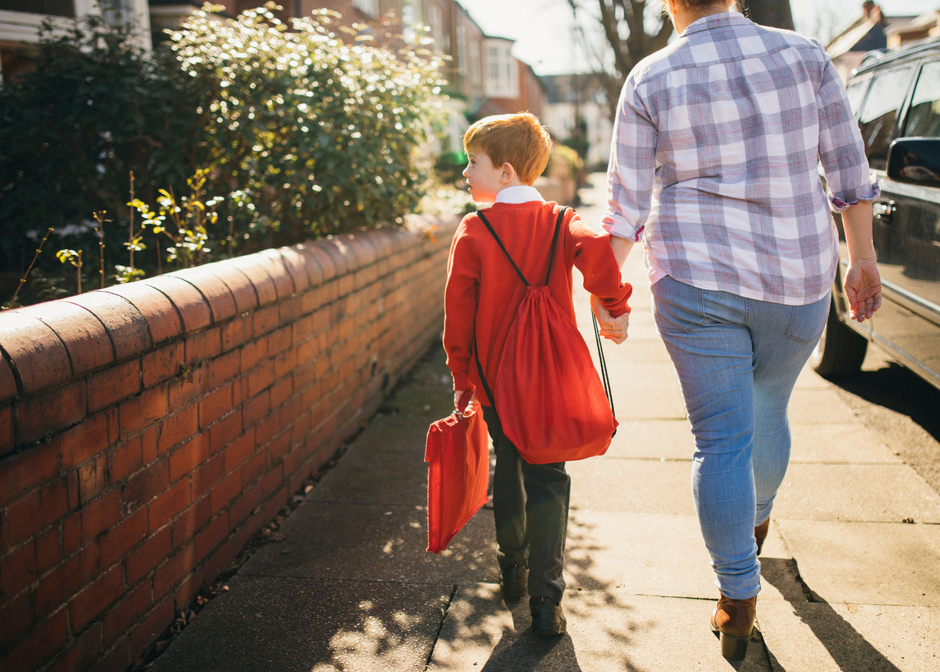


St. Cuthbert’s Catholic
Primary School
Punctuality
Being at school, on time and ready to learn with the rest of the children and staff in school is vitally important to your child’s education. Our school gates and doors open at 8.40am and children should all be in class, ready to learn by 8.55 at the very latest. All lessons have begun by 8.55am so arriving after this time means your child is missing lessons.
Persistent lateness has a very negative impact on your child’s learning and how they feel about the rest of the school day. 10 minutes of lateness every day adds up to 50 minutes of learning every week and 5 hours of missed learning each half term- that is a full school day of learning.
If your child is 10 minutes late each day they will miss half their phonics or spelling lesson each day or half of their maths meetings. They will also miss their reading sessions and can miss having jobs and responsibilities around school as they aren’t here on time.
Children DO NOT like to begin their day after everyone else. When they start school late they have missed registration, missed information about the rest of the day, missed instructions for the lesson they are late for and missed the chance to talk to their friends.
As adults, we don’t like being late when meeting people or going places. If your child is persistently late they have this feeling every morning.

Slide 10
St. Cuthbert’s Catholic
Primary School
Punctuality
Poor punctuality or leaving before the end of the school day is not acceptable.
Missing just 10 minutes of a school day is the same as missing two weeks over the year.
Pupils who arrive late and / or leave early also disrupt lessons which can be embarrassing for the child and can in turn, encourage absence. It is also extremely disruptive for the rest of the class.
  School gates open at 8.40am and close at 8.55am. All children must be in class, ready to begin learning by 8.55am at the latest.
  The school day ends at 3.25pm and the gates and doors are closed again by 3.35pm.
  Registers close at 8.55am. If your child comes to school after this time they are registered as late.
If you need support, or you are worried about your child's attendance or punctuality, please talk to us by emailing keepingintouch@stcuthberts.email, phoning 0191 691 9876 or speaking to us at the school gate.

